Slide 1
Data scenarios
2019.1b:
2023 model with updated data: GAP diffs included, updated L-W
2019.1c:
Correct LLSrv SD & lcomps
Set fishery ISS at number of hauls from which samples used
Use surveyISS for trawl survey length & CAAL comps
Set plus bin at 105 cm (<2% of years for all data >0.01)
Switch to CV for young/old growth with priors from EBS model (estimated here)
Add prior to Lmin (w/ 5% CV)
Turn off forecast recruitment phase
Turn off start_logit param for survey selex
2019.1d:
Update ageing error (linear, GOA data)
2019.1e:
New fishery length comps (aggregate at tri-area-gear, remove filter, merge state)
2019.1d/e.2:
Bin length data at 2 cm bins
2019.1d/e.5:
Bin length data at 5 cm bins

Slide 2
Model scenarios
2024.0:
Time-invariant trawl survey selex
2024.1:
Time-invariant fishery selex
2024.2:
Use trawl survey CAAL only, fit fishery age post-2007

Slide 3
Base data differences
Trawl survey: GAP cleaned up old haul data, only includes specimen data associated with a haul that is used to compute abundance
Resulted in very minor differences in early trawl survey time series for abundance and comp data
LL survey:
Log correction in SD hadn’t been applied (but was applied to bottom trawl survey index), now is applied
Length comps off by a cm (i.e., 25 cm fish became 26 cm)
Fishery comps:
ISS set at total number of hauls sampled, but filtered hauls to a certain sample size and didn’t take this into account
Length-weight relationship continually updated

Slide 4
Base data differences
Plot of base model vs data update model

Slide 5
Base data updates
Ageing error updated

Slide 6
Base data updates
Ageing error updated plots

Slide 7
Len comp inv
Post-91 data filtering: >10 per haul in fed data
Proportion of hauls removed:
 | Longline | Pot | Trawl
1991-2012 | 2% | 4% | 3%
2013 | 12% | 12% | 2%
2014 | 6% | 14% | 5%
2015 | 5% | 8% | 4%
2016 | 13% | 10% | 4%
2017 | 12% | 12% | 20%
2018 | 23% | 6% | 6%
2019 | 22% | 10% | 6%
2020 | 60% | -- | 79%
2021 | 20% | 14% | 72%
2022 | 6% | 30% | 76%
2023 | 34% | 36% | 68%

Slide 8
Len comp inv
State data used to ‘fill-in’ missing fed data:
2 steps:
Step 1: uses state data if has more than fed data
Step 2: uses state data if more than 30 lengths observed (at tri-area-gear level)
Amount of state data not used:
Step 1 | Longline | Pot | Trawl
1997-2016 | 34% | 37% | 56%
2017 | 33% | 0% | --
2018 | 20% | 0% | --
2019 | 20% | 0% | --
2020 | 0% | 0% | --
2021 | 0% | 0% | --
2022 | 0% | 0% | --
2023 | 0% | 0% | --

Slide 9
Len comp inv
Post-91 data filtering: >10 per haul in fed data
Propose: remove filter and include all data
State data used to ‘fill-in’ missing fed data
So, if fed data exists in a trimester-region-gear combo, use fed data no matter how much available compared to state
Propose: rather than ‘fill-in’, merge with fed data
Requires restructure of how fed length comp data computed
Fed length comp computed at week-area-gear level, difference would require to aggregate at trimester-area-gear level
Time-area-gear aggregation
Propose: simplify and aggregate at trimester-area-gear level rather than week-area-gear

Slide 10
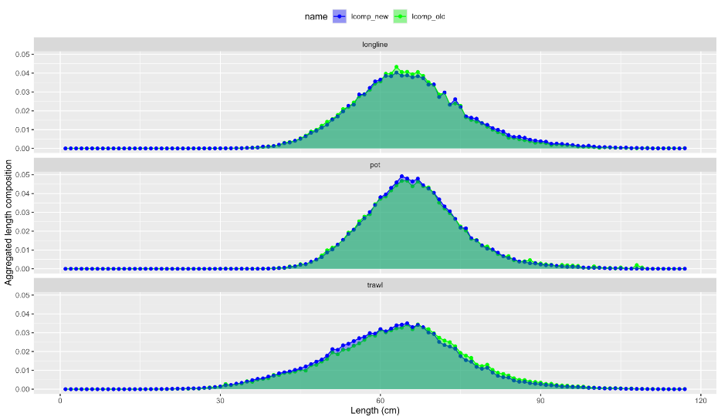
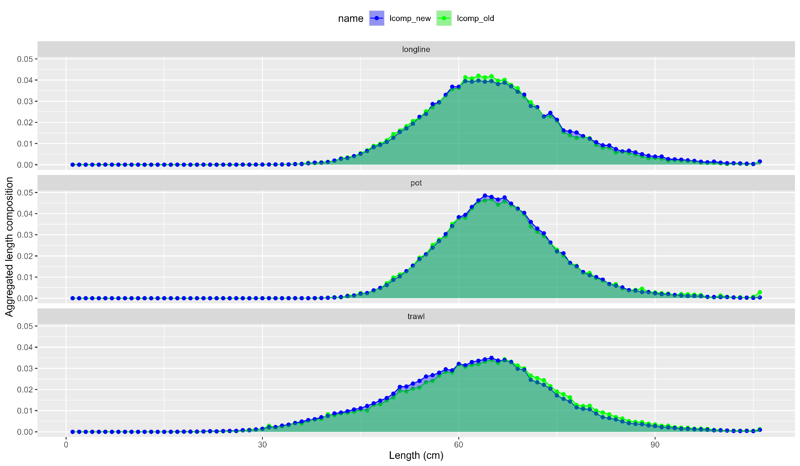
Len comp inv
Aggregated comps:

Slide 11
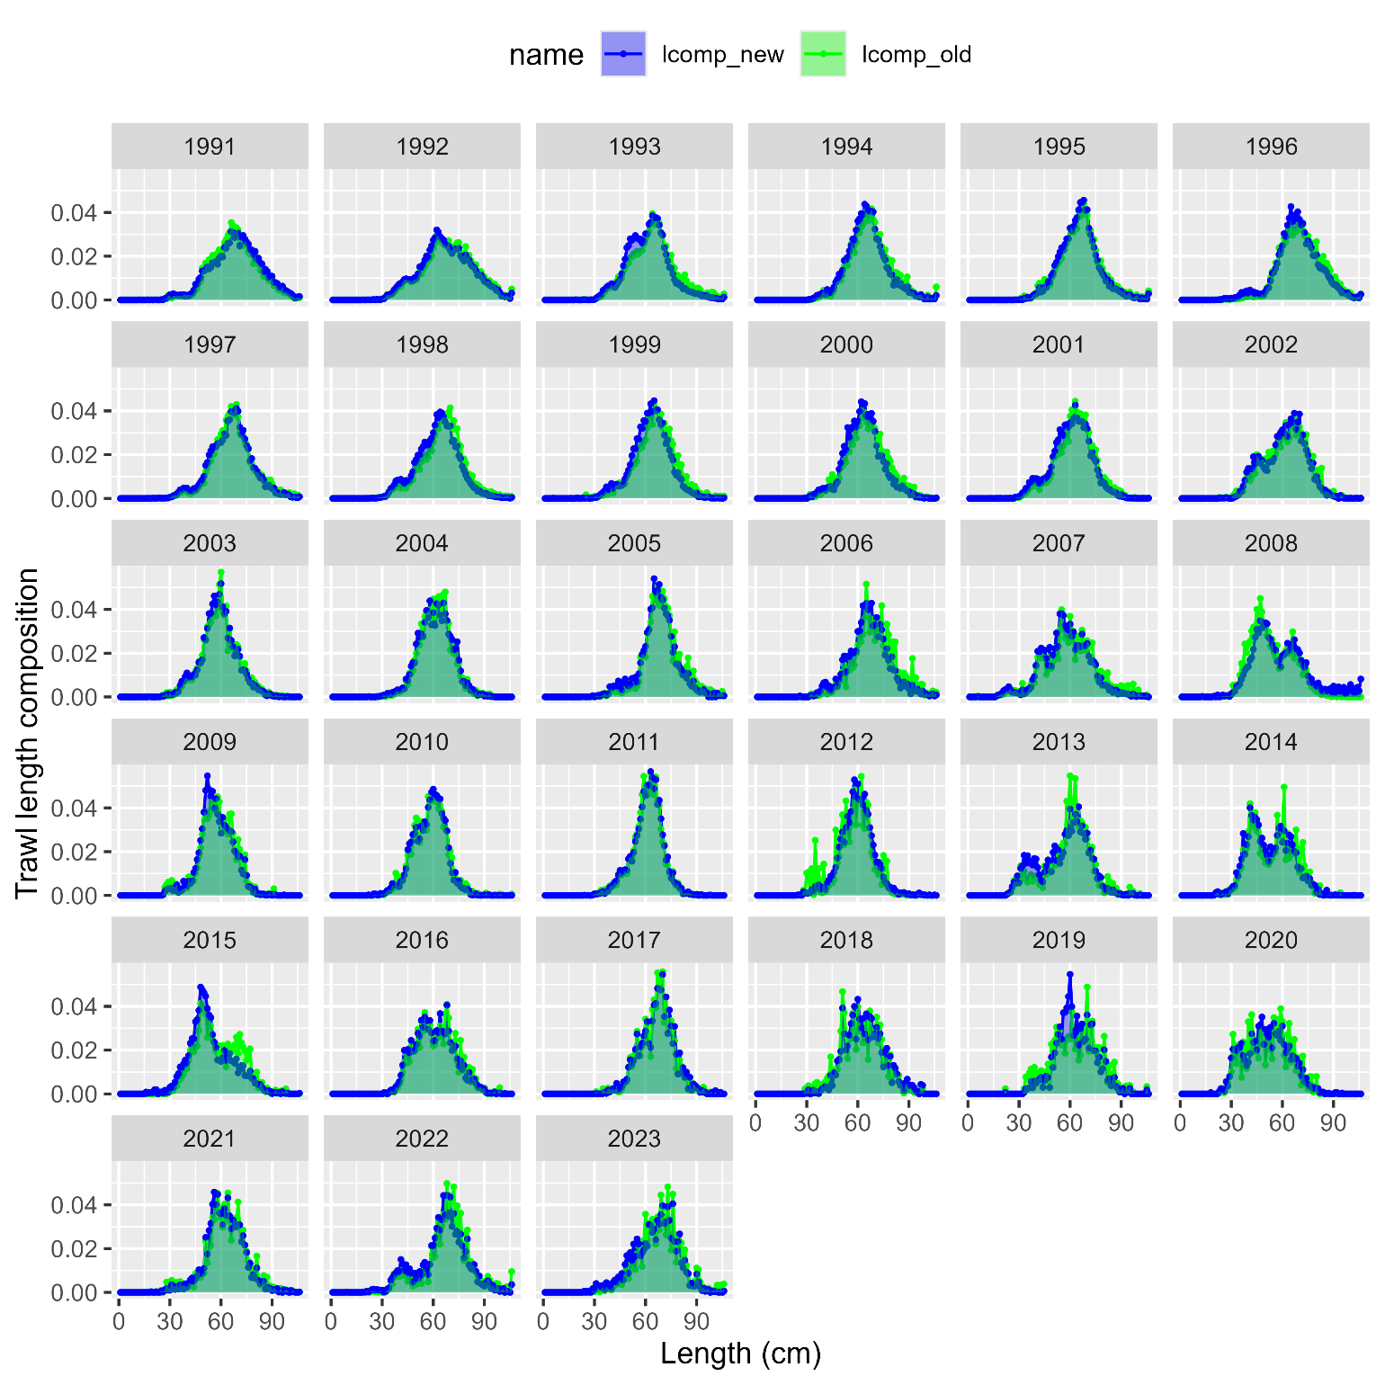
Len comp inv
Trawl comps:

Slide 12
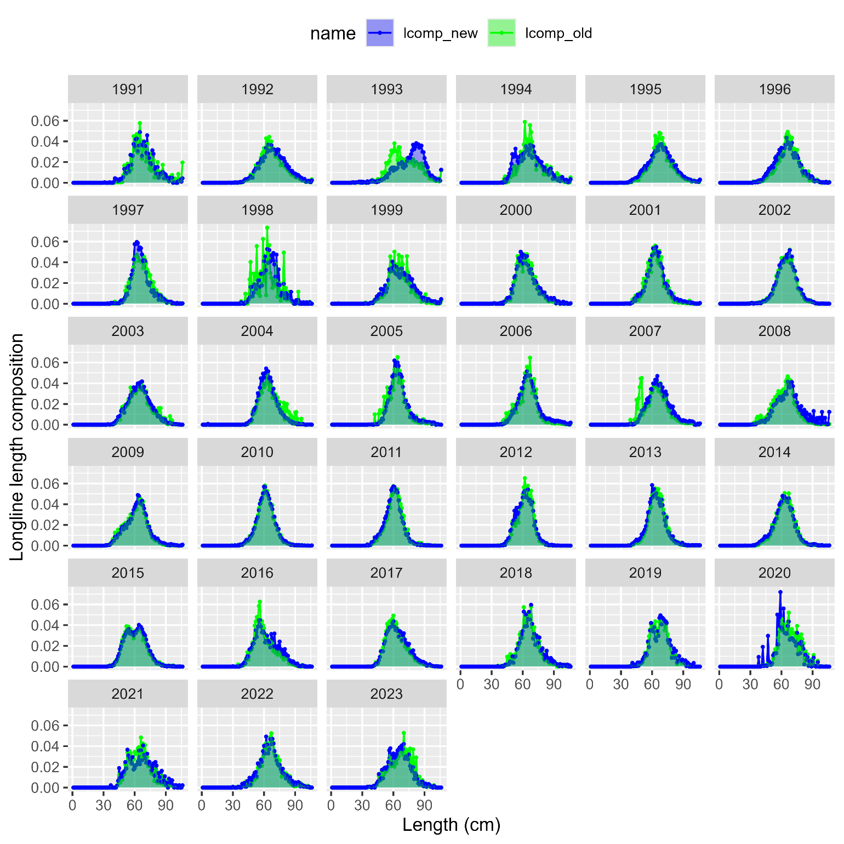
Len comp inv
Longline comps:

Slide 13
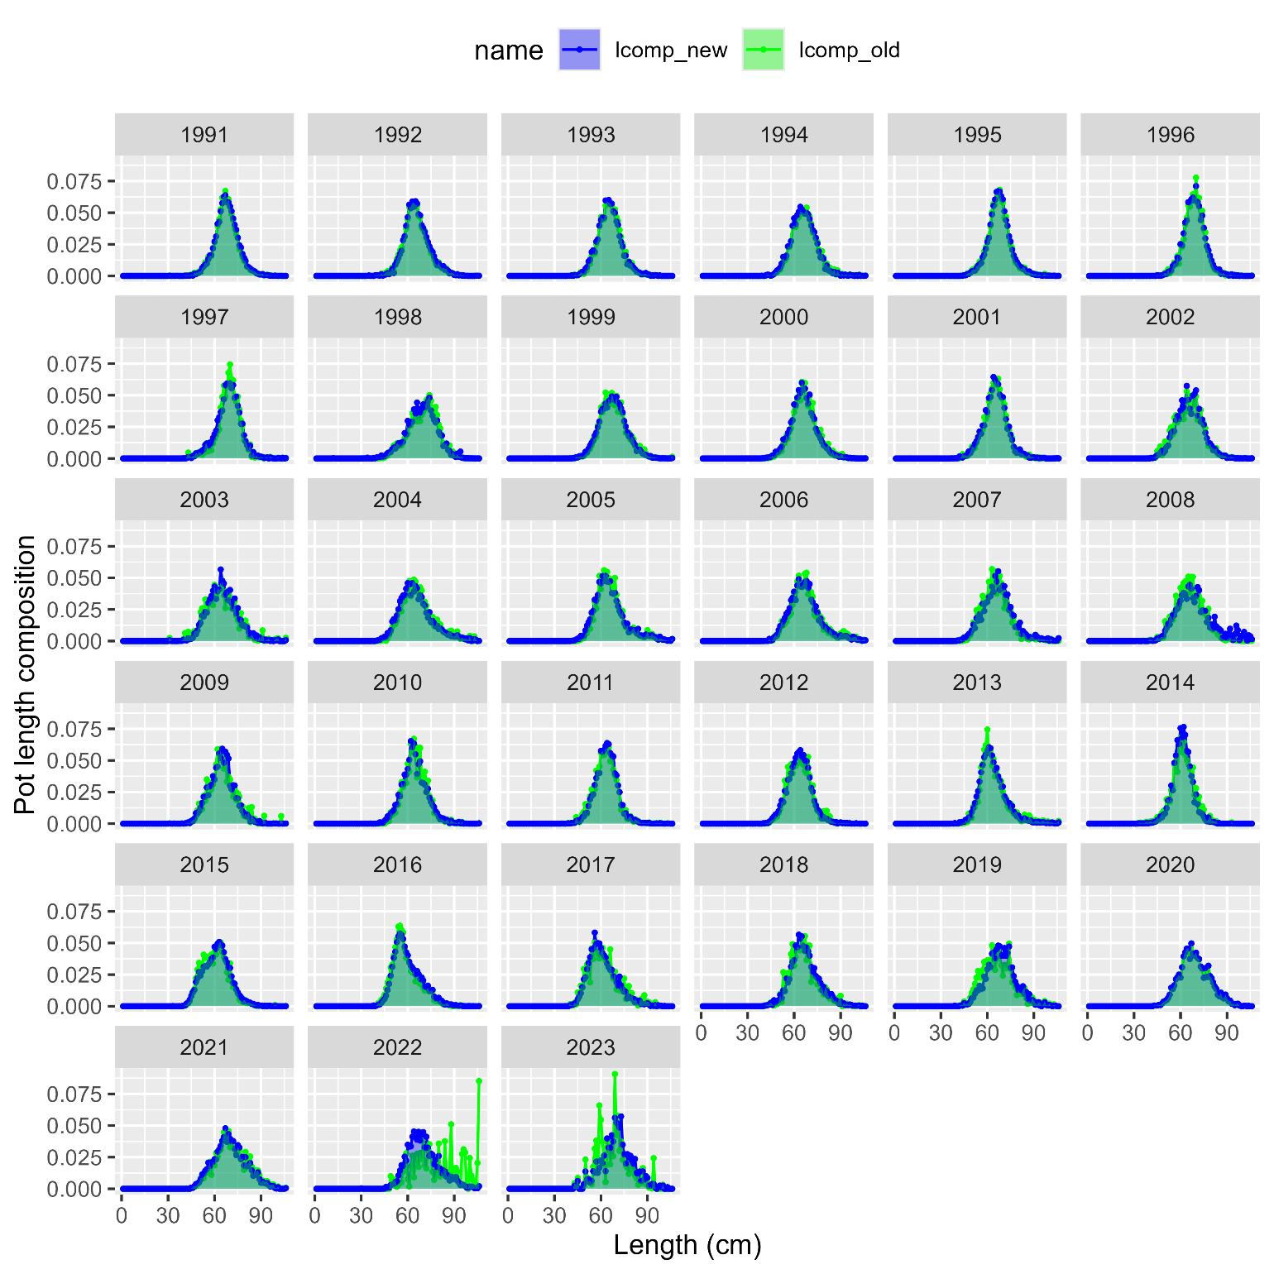
Len comp inv
Pot comps:

Slide 14
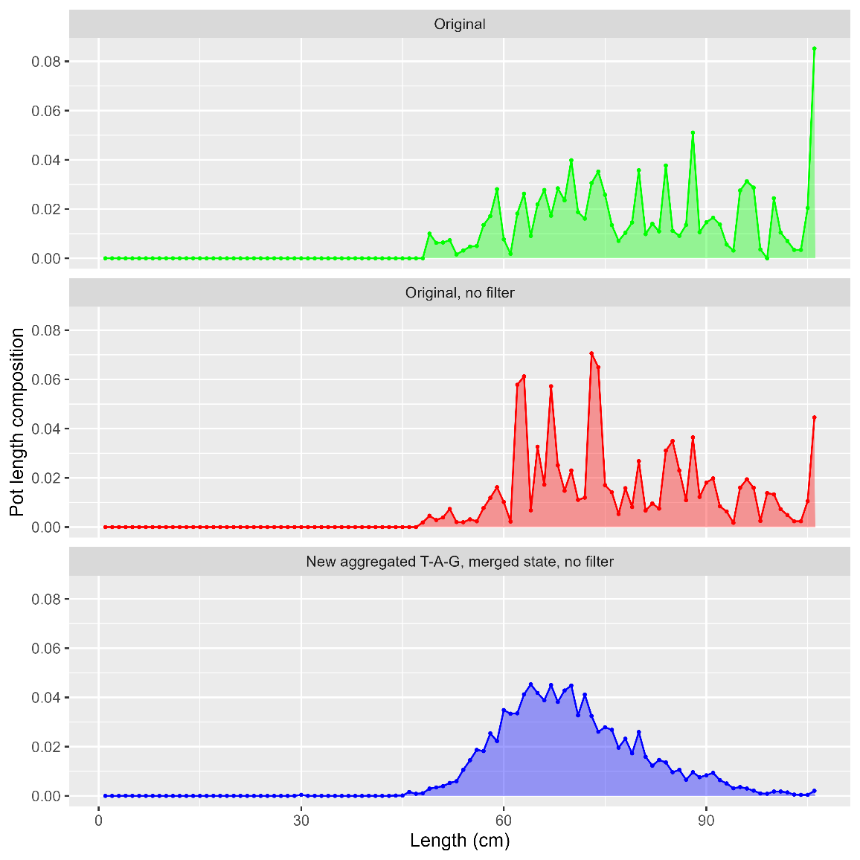
Len comp inv
37 hauls
n = 698
No state
Pot comps:
53 hauls
n = 794
No state
n = 6417
With state

Slide 15
Len comp inv
Overall, removing filters, aggregating at trimester-area-gear level and merging state data helps to smooth out much of the variability in fishery length comps
But, only gets us so far
Proposal: align with EBS cod investigations this year, and investigate binning length data at 5 cm intervals
Affects: all length comp (surveys & fishery) and conditional age-at-length (trawl survey and fishery)

Slide 16
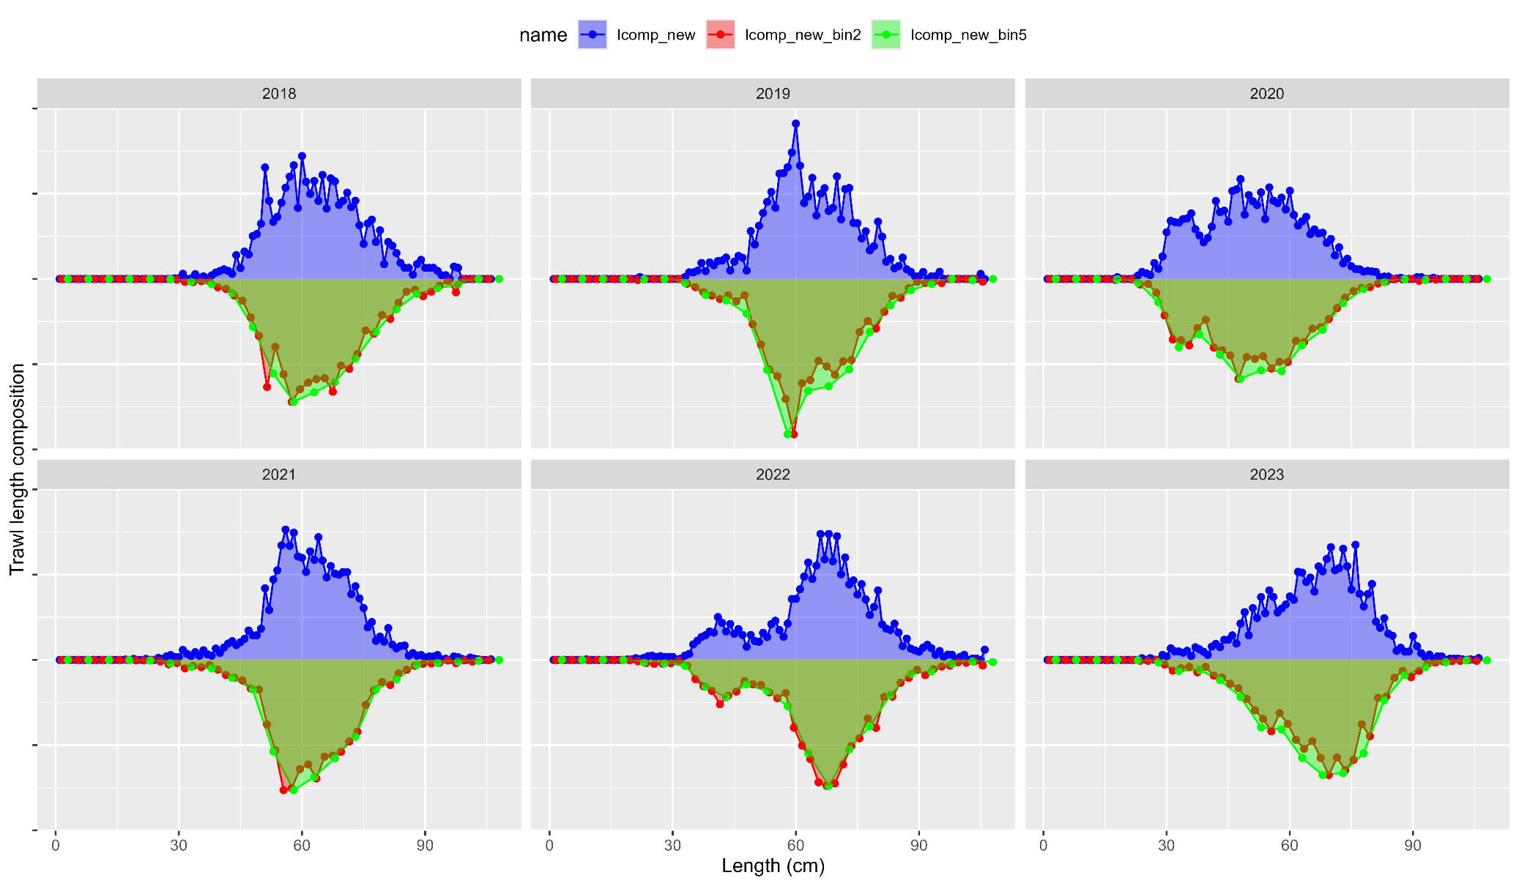
Len comp inv
Bin trawl:

Slide 17
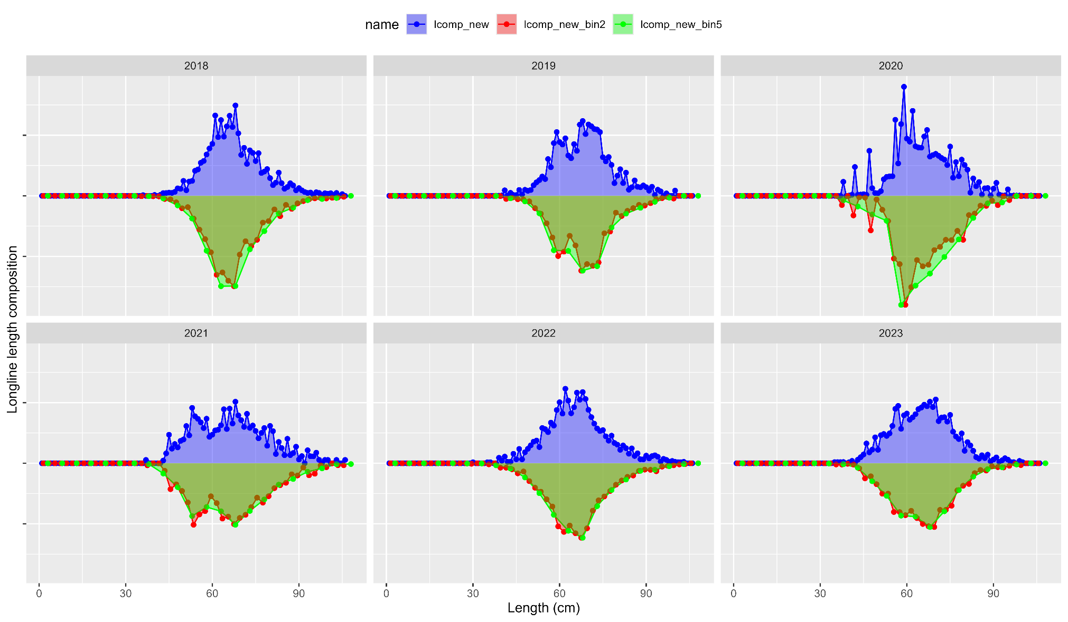
Len comp inv
Bin longline:

Slide 18
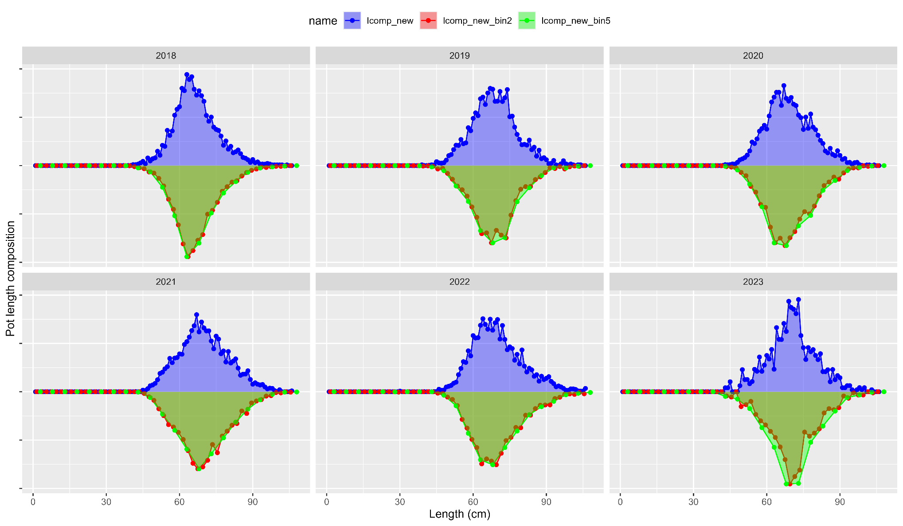
Len comp inv
Bin pot:

Slide 19
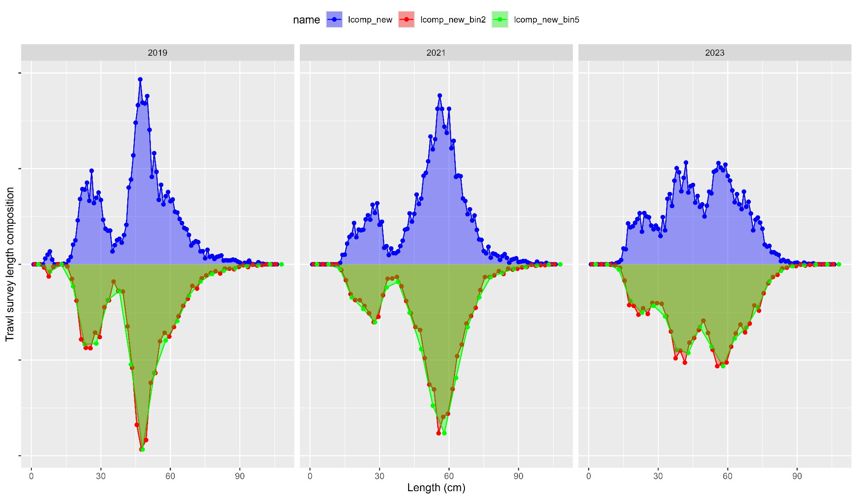
Len comp inv
Bin trawl survey:

Slide 20
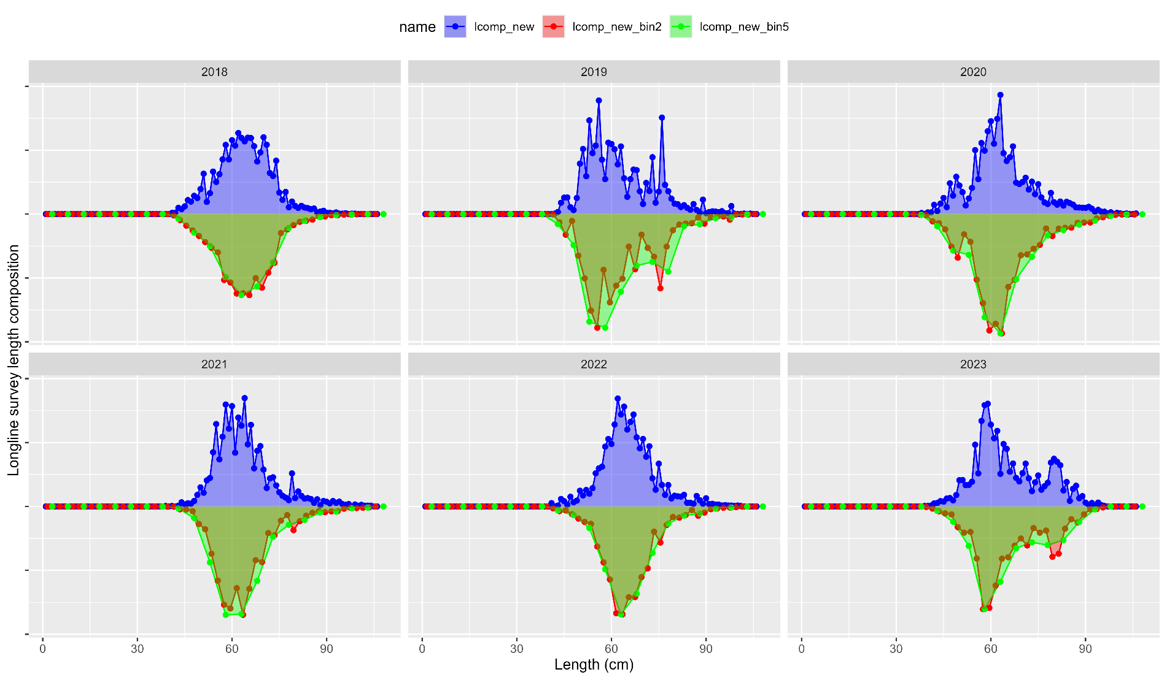
Len comp inv
Bin longline survey:

Slide 21
Len comp inv
Overall, removing filters, aggregating at trimester-area-gear level and merging state data helps to smooth out much of the variability in fishery length comps
And, binning to 5 cm removes variability in length composition without loosing important signal
Proposal: add this data treatment as alternative model ###

Slide 22
Len comp inv
Plots of alternative model with lcomp data treatment ## vs alternative model with bin ##

Slide 23
Age comp inv
Fishery data:
Currently computed for males/females, then combined (and, excludes unsexed data)
But, length comps have never been computed this way, have always combined sex data prior to expansion
Computed with FSA package, rather than the observed ALK
Idea: randomly assigns lengths to ages with an ALK approach
But, can obtain ages that weren’t observed, particularly because
Requires: must define smallest lengths in each year as age-1
Propose:
Combine age/length data across sexes pre-expansion
Use year-specific ALK & remove age-1 assignment (stop using FSA package)
Use proposed length comp expansion
Why? You’ll see…

Slide 24
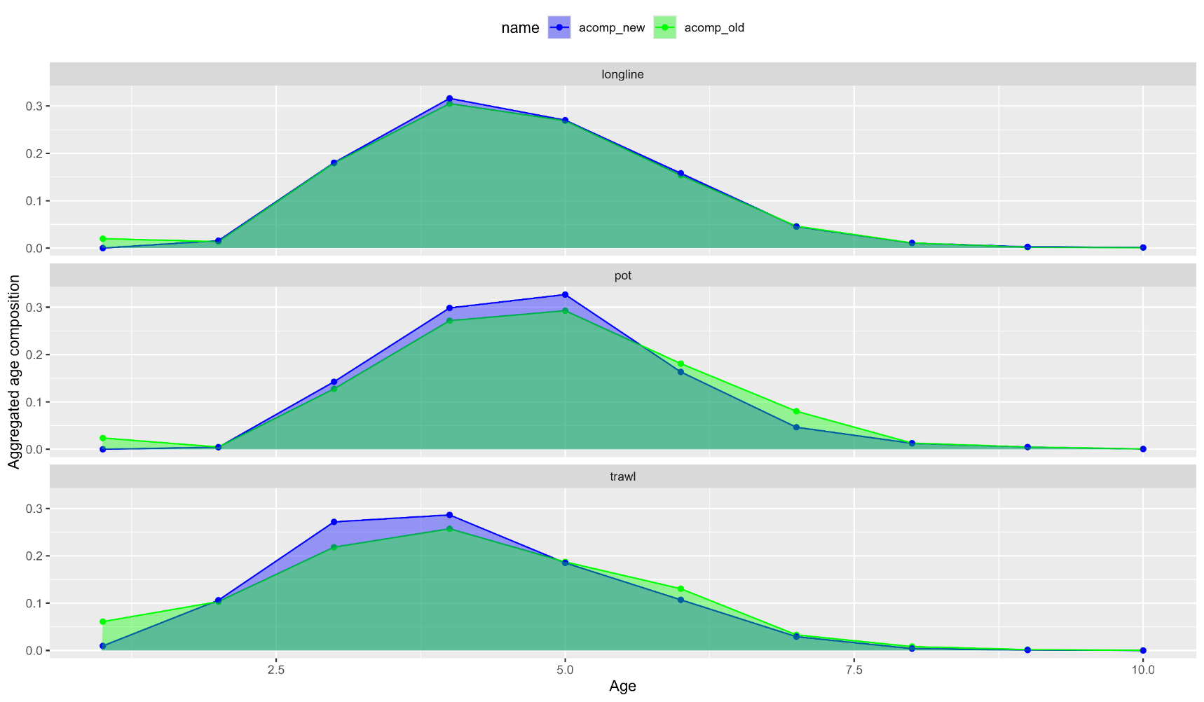
Age comp inv
Fishery data: aggregated plots

Slide 25
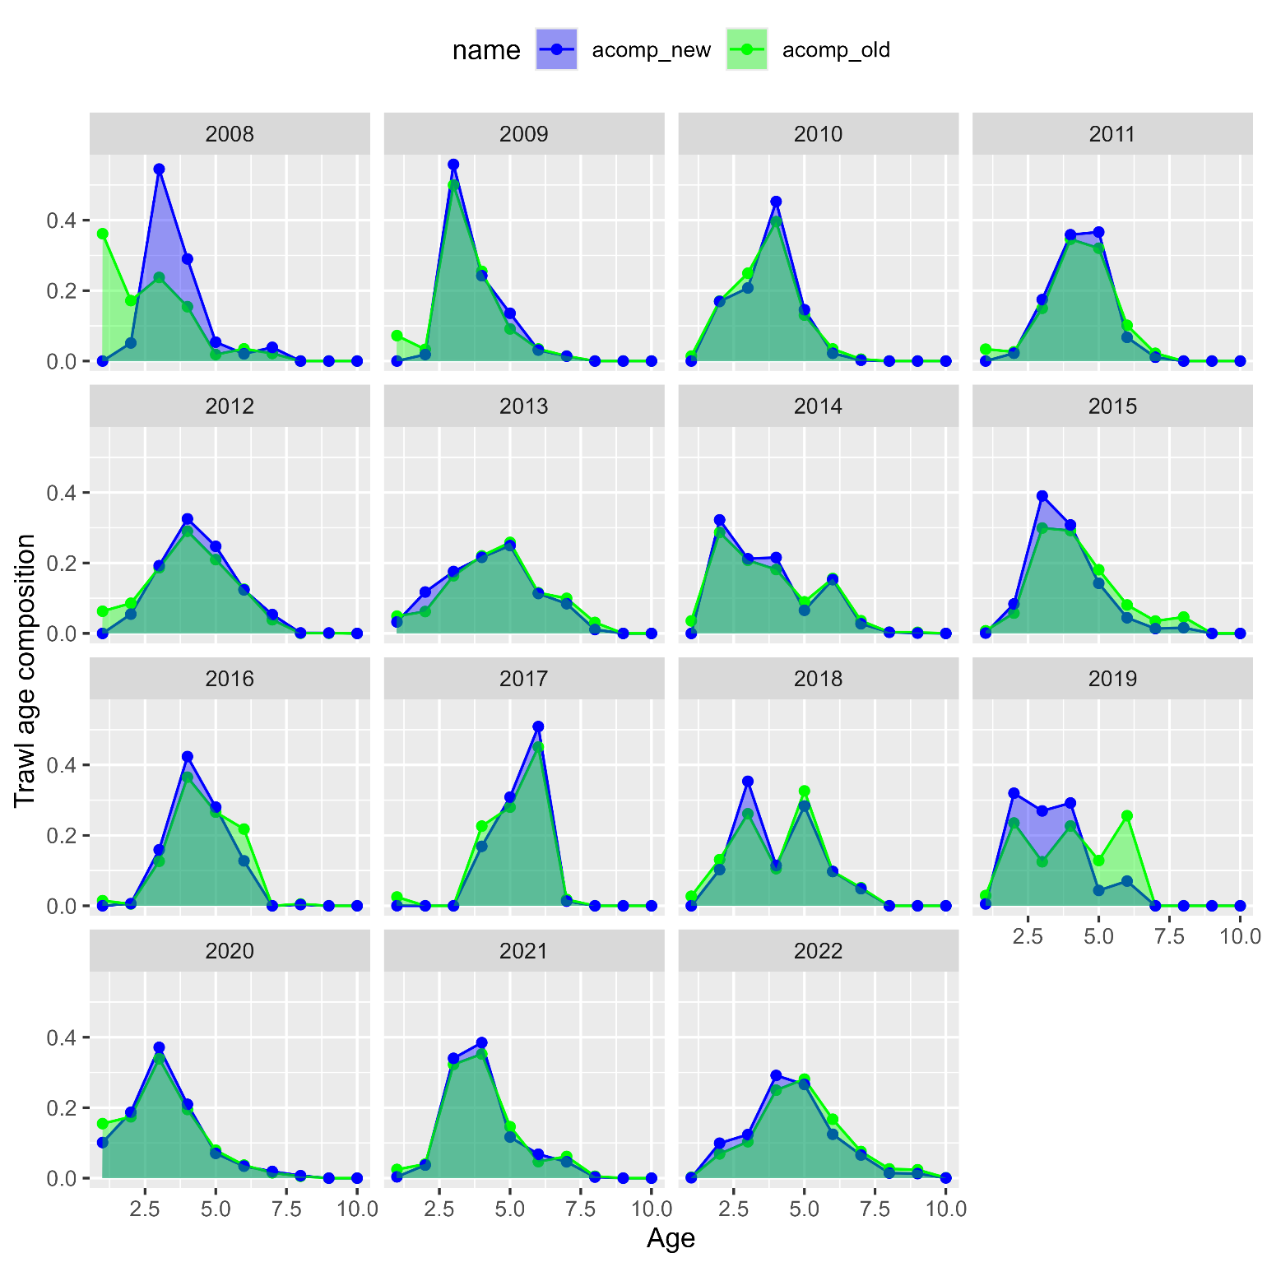
Age comp inv
Trawl fishery:

Slide 26
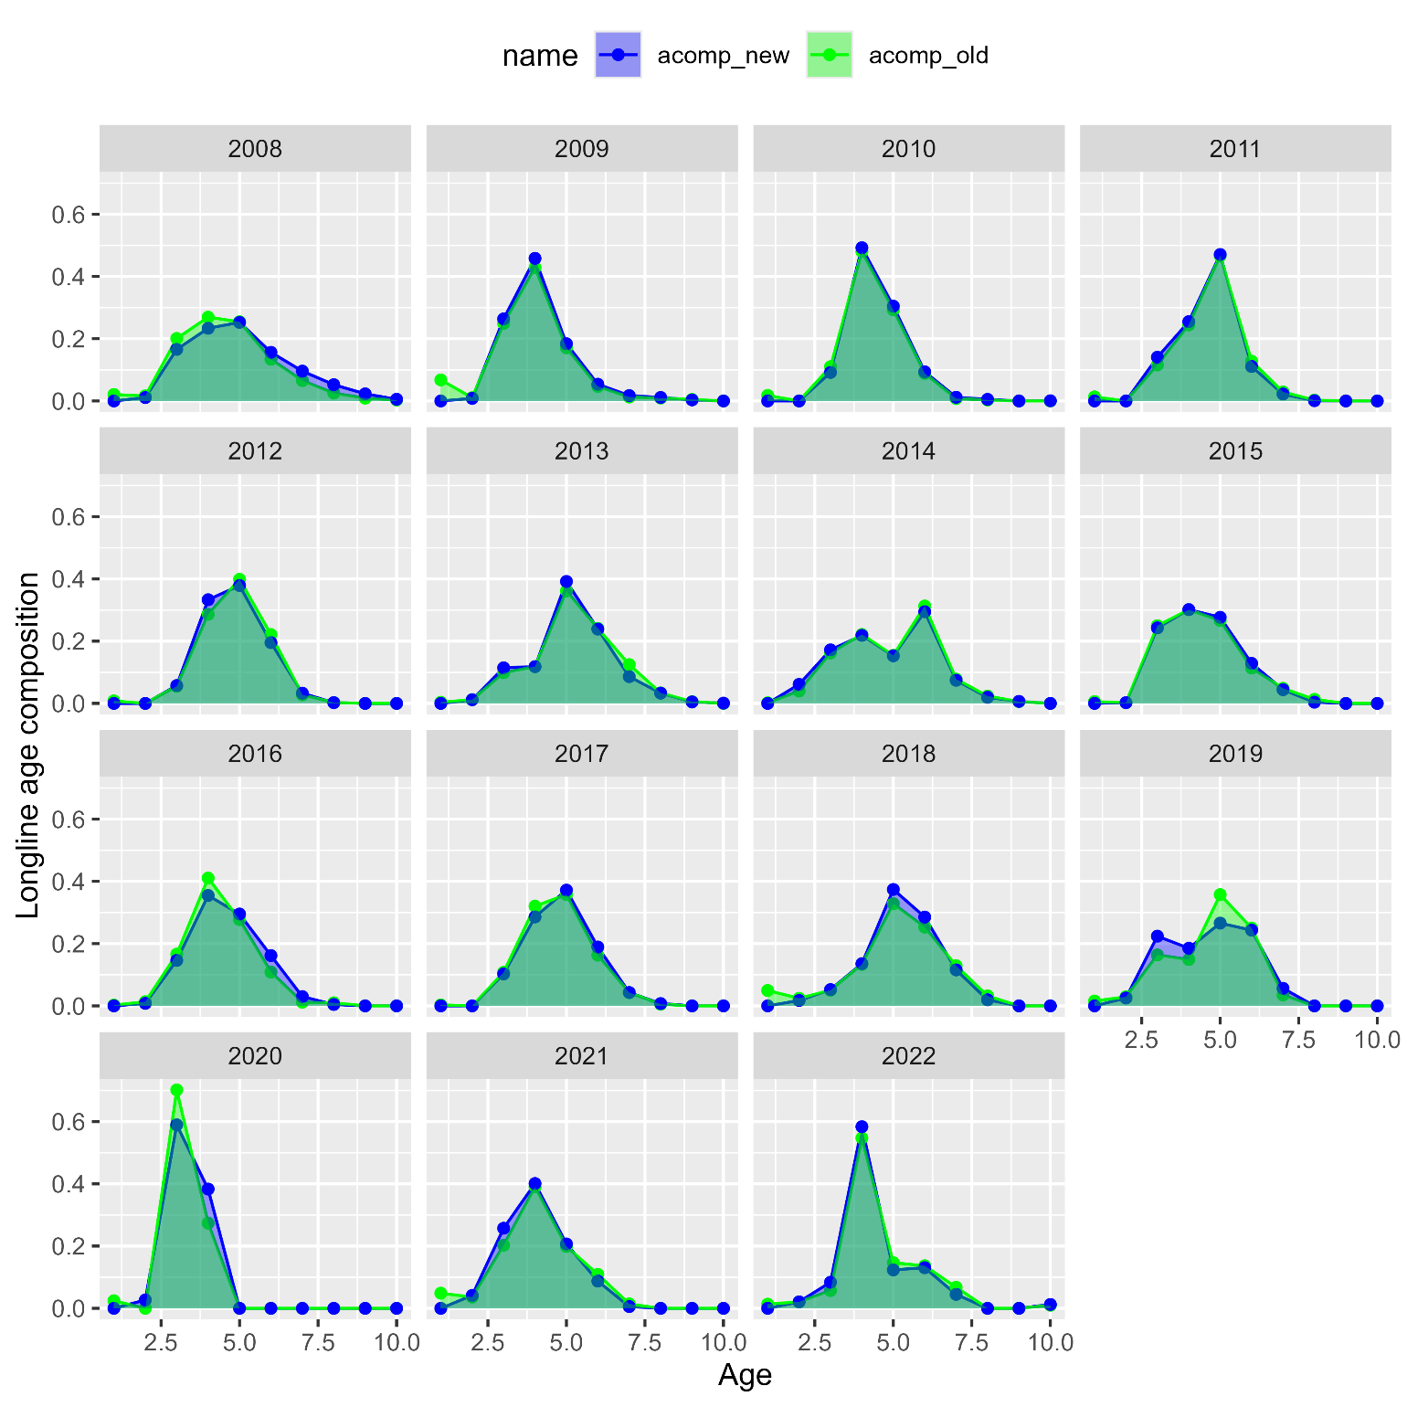
Age comp inv
Longline fishery:

Slide 27
Age comp inv
Pot fishery:

Slide 28
Apport inv
Reminder: LLS used in assessment as additional pop’n index, but not used in apportionment
And, includes an environmental link, where in warmer temps at depth cod move deeper and are more available to the LLS than in colder years
Including it in apportionment has been talked about for some time
Other, ‘tracked’, pop’n indices include IPHC FISS and ADF&G large mesh trawl survey

Slide 29
Apport inv
Here, look at including LLS into rema as an additional index to be used for apportionment
Step-wise approach:
First, look at AIC ‘preferred’ model when it comes to Process Error (PE) and index scaling (q) parameters
Next, with ‘preferred’ models investigate estimating additional observation error

Slide 30
Apport inv: Step 1
4 cases: factorial design of global (1), or regional (3) PE and q parameters
PE = 1, q = 1
PE = 3, q = 1
PE = 1, q = 3
PE = 3, q = 3

Slide 31
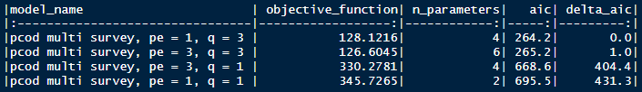
Apport inv: Step 1
AIC suggests that regional scaling parameters q are supported (and most influential)
Whether PE = 1 or 3, no real difference in model
So, to cover our bases, select PE = 1, q= 3 and PE = 3, q = 3 for additional uncertainty analysis

Slide 32
Apport inv: Step 2
6 cases: factorial design of 2 PE-q cases from step 1 x 3 uncertainty cases:
Additional uncertainty in trawl survey
Additional uncertainty in longline survey
Additional uncertainty in both

Slide 33
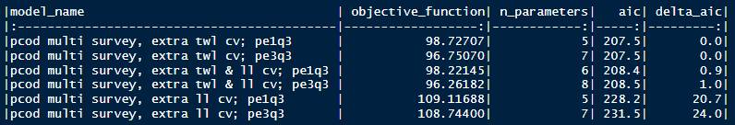
Apport inv: Step 2
Results in 4 models that are essentially the same, in terms of AIC
Preferred model:
For PE-q, argue for parsimony: select PE = 1 and q = 3 case
For additional uncertainty, argue:
When adding trawl survey uncertainty, largest decline in AIC (and is significant)
Acknowledge that these don’t include environmental link for longline survey, so, there’s a sources of uncertainty that we haven’t yet explained in this model
So, select additional uncertainty in both

Slide 34
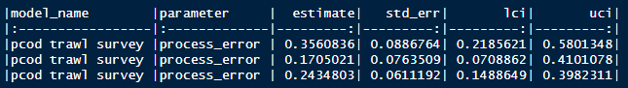
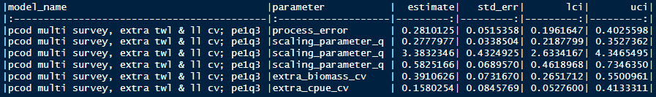
Apport inv: Comparisons
Compare between:
Base model: trawl survey only (pcod trawl survey)
Preferred model: both trawl and longline survey with 1 process error parameter, 3 scalar parameters, and additional uncertainty estimated for both surveys

Slide 35
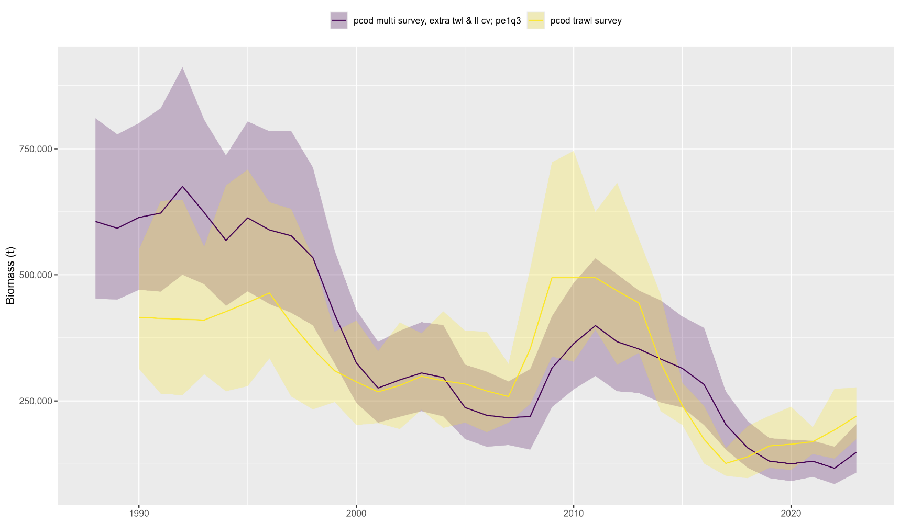
Apport inv: Comparisons
Estimated biomass:

Slide 36
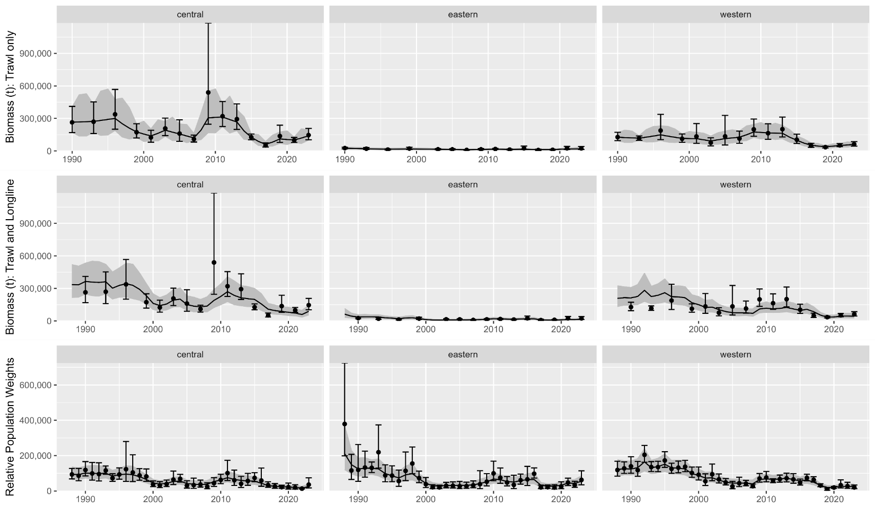
Apport inv: Comparisons
Data fits:

Slide 37
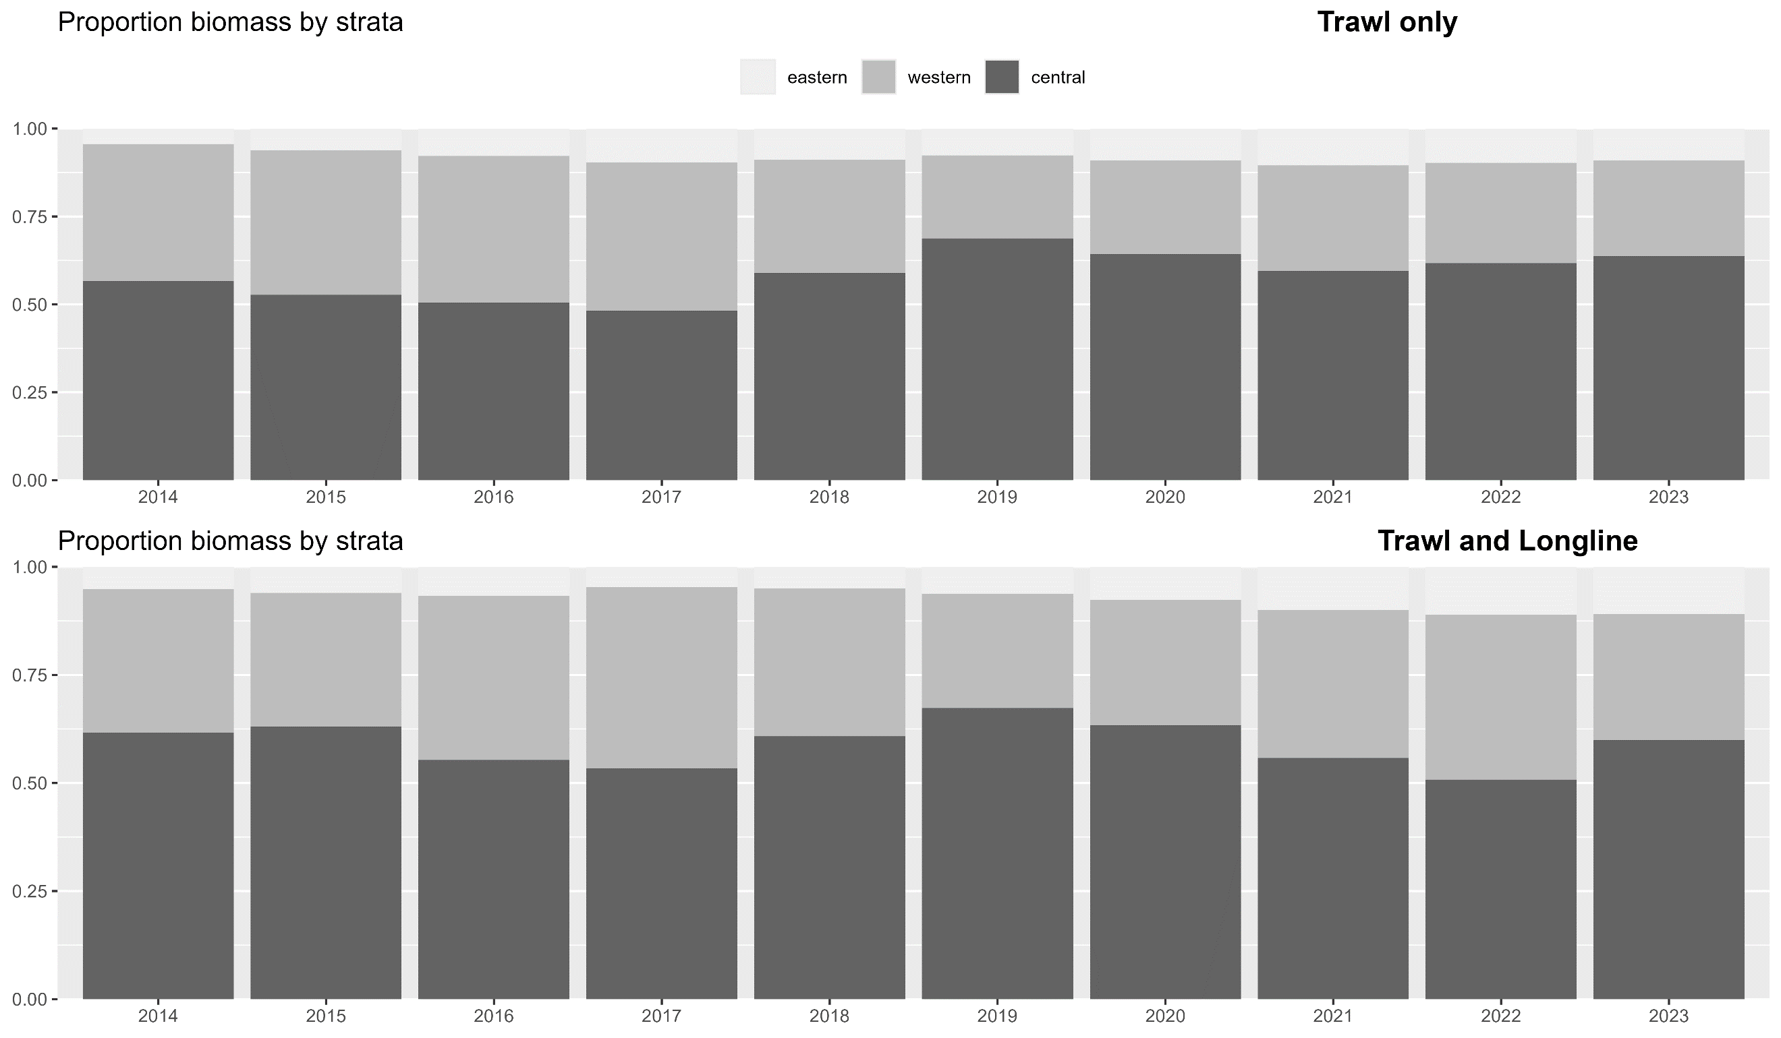
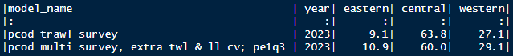
Apport inv: Comparisons
Apportionment:

Slide 38
Apport inv: Discussion
Recommendation: use rema with additional index with preferred parameterization
Makes apportionment consistent with data used in assessment
But, it will likely result in more variable apportionment compared to using only trawl survey
Next steps:
Working on environmental index, will be looking towards region indices to potentially be used in apportionment
Survey timing is slightly different in each region, whether/if this results in different environmental conditions by region remains to be seen
Currently rema not developed to include environmental index

Slide 39
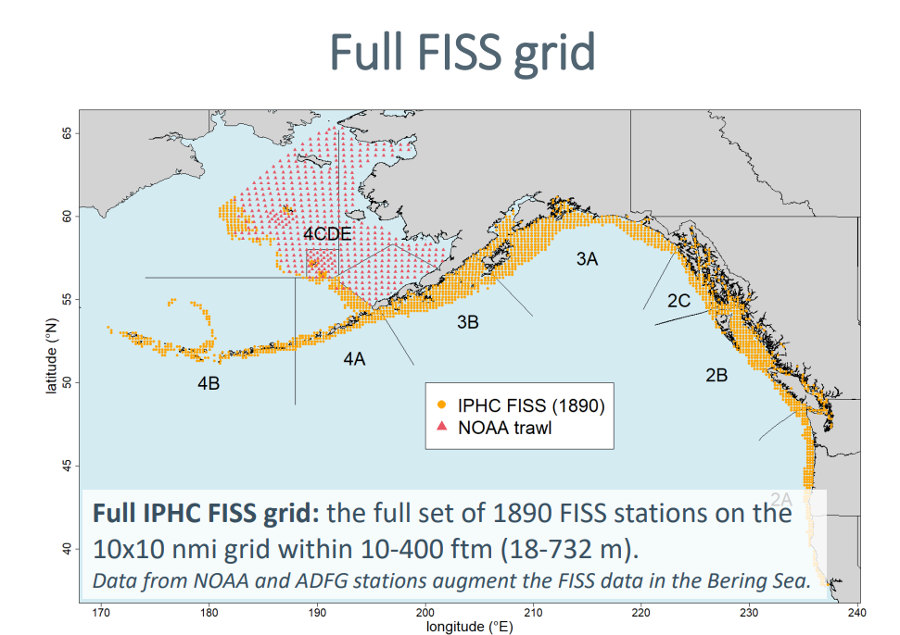
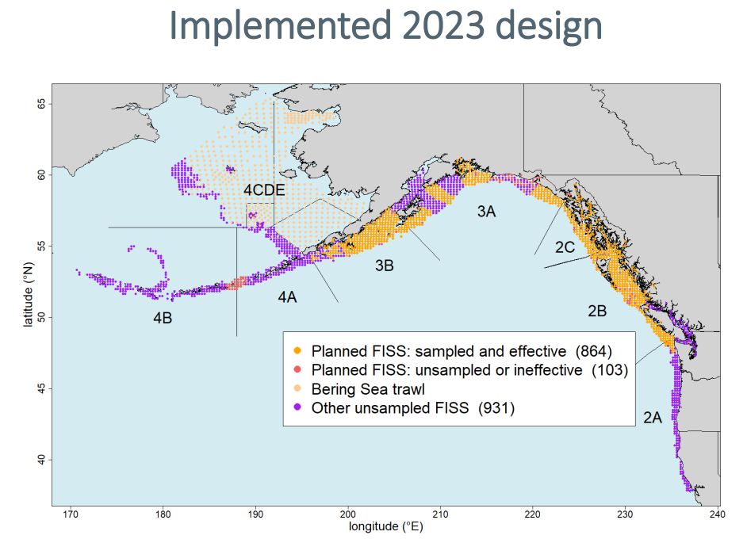
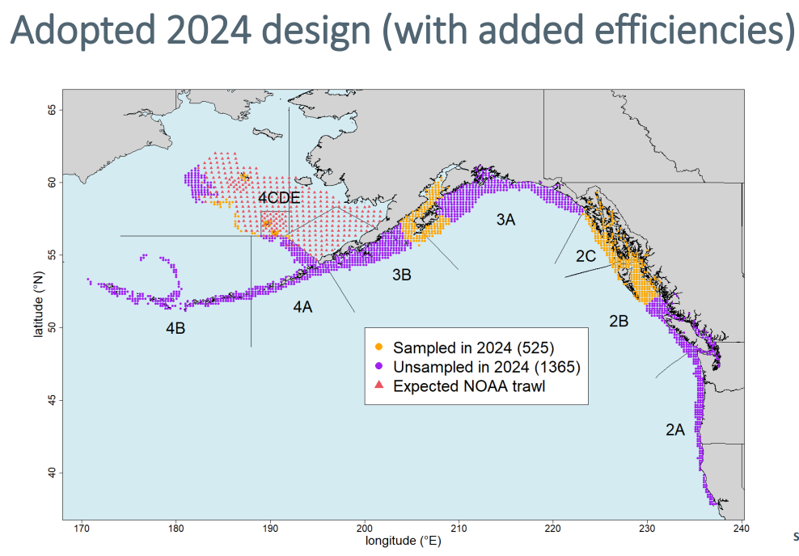
Apport inv: Discussion
Other indices: IPHC FISS
Has always been a promising additional index for apportionment, but, recent developments have made implementation questionable for Pacific cod
Recommend: not consider FISS as viable alternative index for Pacific cod until stations randomly subsampled or full FISS design is implemented

Slide 40
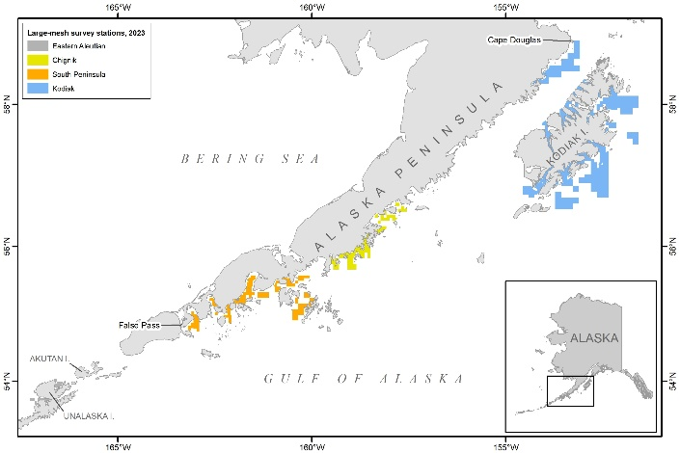
Apport inv: Discussion
Other indices: ADF&G large mesh survey
Rub here: only samples western and central gulf
But, if there is additional information about trend in these two subregions, could possibly use it in rema
However, rema currently not capable of including third index
Recommend: for now continue to track ADF&G survey in assessment, but since we have 2 indices in rema that have good spatial coverage, not spend time yet developing this as an additional index

